Slide 1


Analysis
of academic
Success
According
to the test
“Saber pro”
using
decision
trees

Slide 2
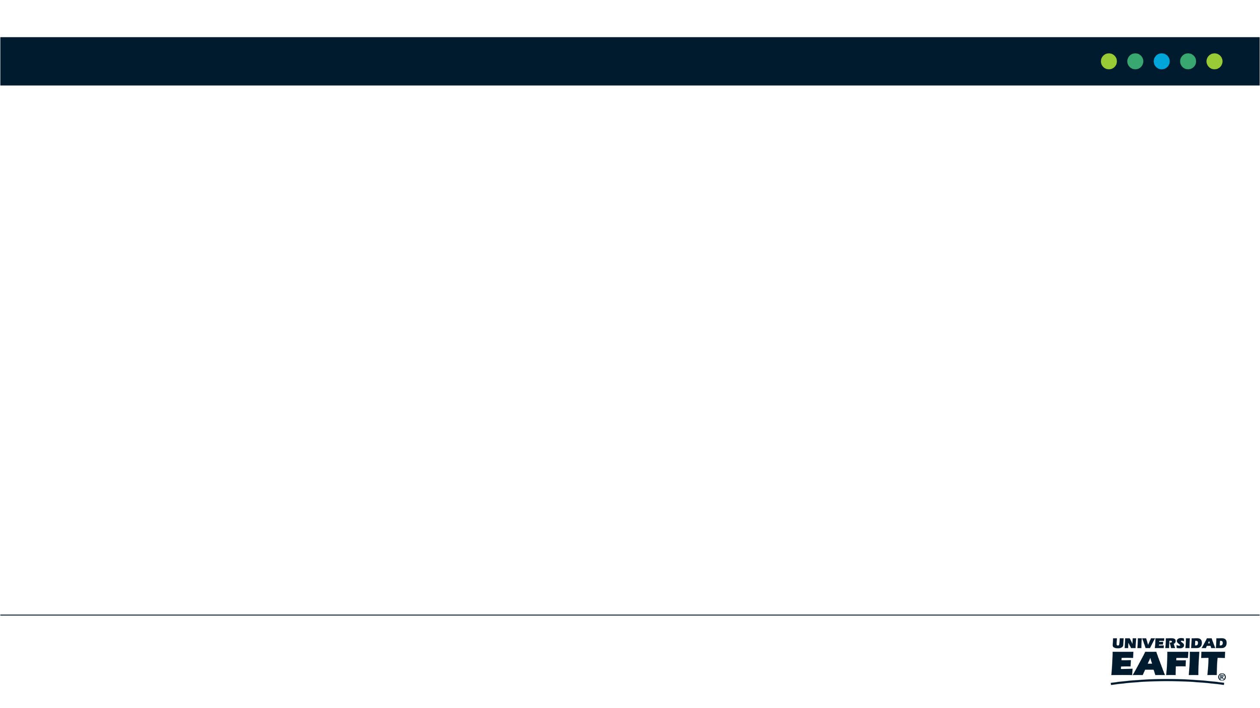


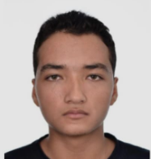


Team Presentation
Juan David Echeverri Villada
Octavio Vásquez Zapata
Miguel Correa
Mauricio
Toro
https://github.com/Juanda0/ST0245-001/tree/master/proyecto

Slide 3
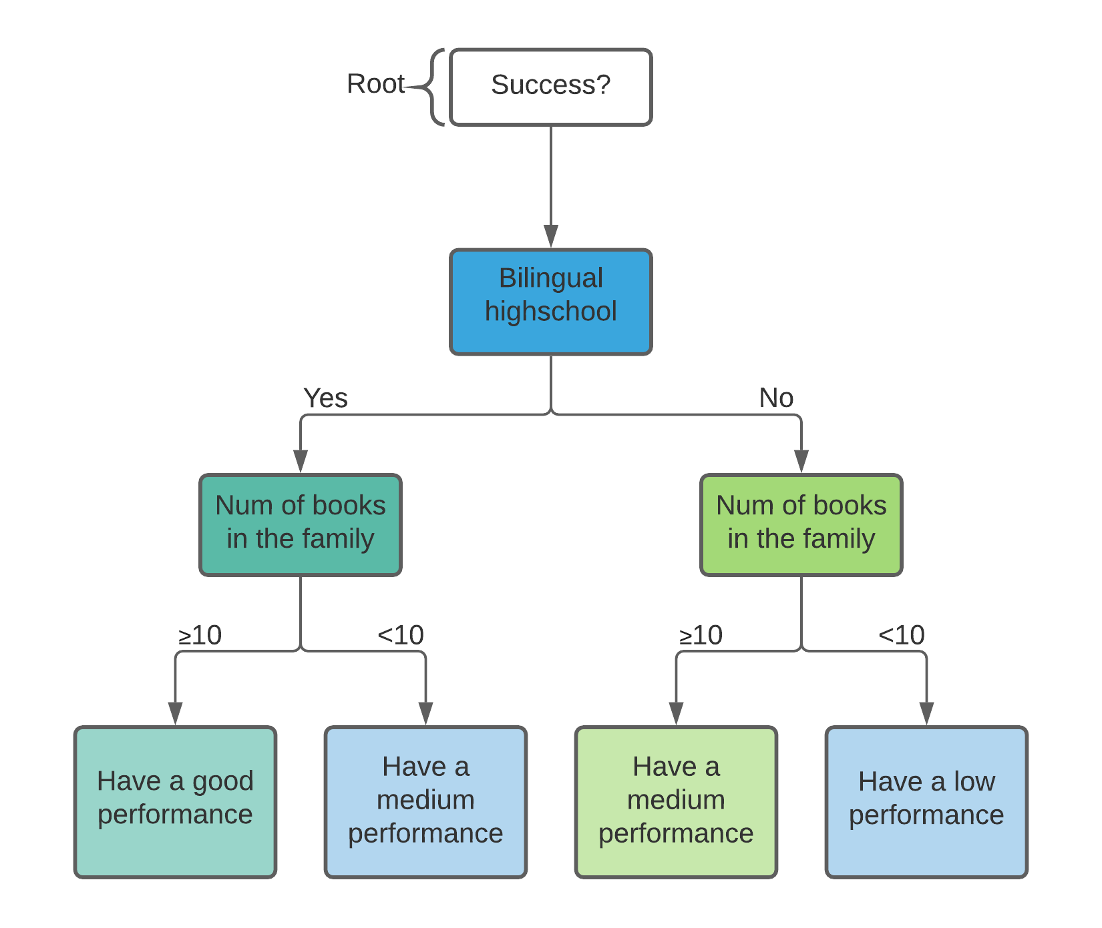

Algorithm Design
The algorithm is designed to filter the datasets according to the conditions that the student matches. It is the responsible to build up the decision tree according to the given parameters.
EL HERALDO(2019), ICFES. HTTPS://BIT.LY/3IAKY9H

Slide 4
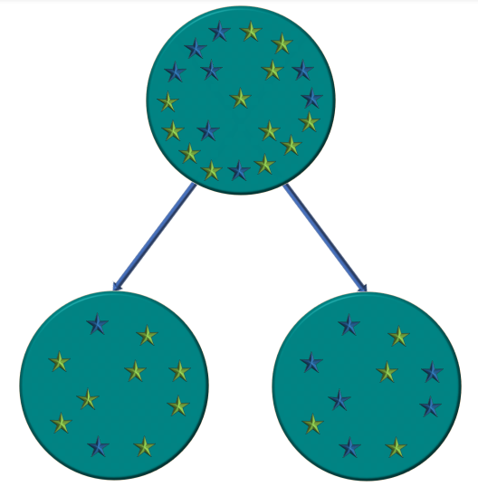
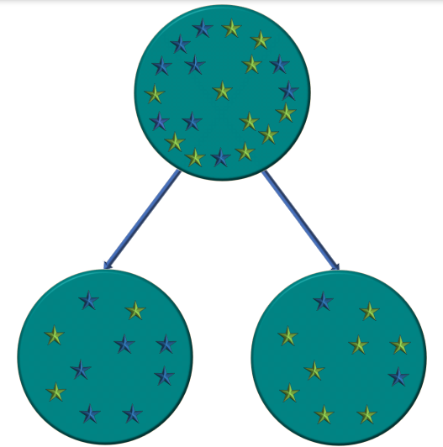
Node Splitting
Took preparation course “Saber 11” English average
Successful students
Other students
No
Yes
< 53
≥ 53
In this node, the split condition is whether or not the student took a preparation course. for this case, left Gini impurity is 0.2493 and each student have the 85,40 % of success, while in the right Gini impurity is 0,4847 and each student have the 41,24 % of success, and weighted Gini impurity is 0,2787 (this is the condition that reduces Gini impurity the most)
in this node, the split condition is whether or not the student got a grade over the average in the English section in “Saber 11”. for this case, left Gini impurity is 0,4331 and each student have the 31,71 % of success, while in the right Gini impurity is 0,2954 and each student have the 81,98 % of success, and weighted Gini impurity is 0,3831
*For the purpose of improving the quality of the data, we decided to ignore the students who did not answered the question

Slide 5


Algorithm Complexity
 | Time Complexity | Memory Complexity
Training the model | O(N*M*2^{M}) | O(N * M)
Testing the Model | O(N*M+N²) | O(1)
Time Complexity of the training and testing algorithms. N represent the number of students in the dataset and M the number of variables used to divide the tree. Due to the implementation of a random forest in our model, Complexity may diverge.
THE CONVERSATION(2013), UNITEST. HTTPS://BIT.LY/2UWFAPZ

Slide 6

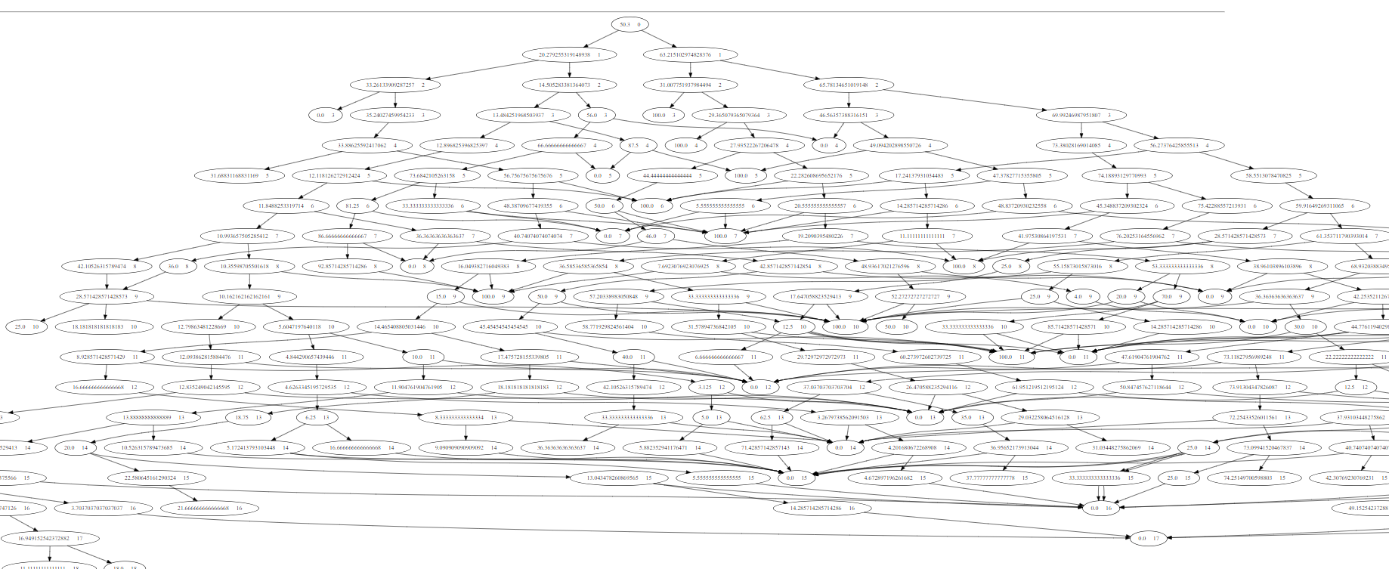



Decision-Tree Model
Language Score >= 57
English Performance == A2
English Performance == A2
Most Relevant Features
True
False
Professional Score >= 55
Professional Score >= 55
Professional Score >= 55
True
False
True
False
English Performance
Professional Score
Language Score
True
False
True
False
True
False
True
False
-
x
x
x
-
✓
x
-
Gini: 0.45
Probability: 65.57 %
Gini: 0.45
Probability: 33,93 %
Gini: 0.47
Probability: 37,62 %
Gini: 0.30
Probability: 18,03 %
Gini: 0.49
Probability: 57,18 %
Gini: 0.32
Probability: 80,25 %
Gini: 0.34
Probability: 21,28 %
Gini: 0.48
Probability: 58,92 %
ES
The first three levels of a binary decision tree to predict Saber Pro scores Based on the data obtained from the students that presented the Saber 11 test. Nodes marked with the symbols 'X', '-' and '✓' represent low, medium and high probability of success respectively.

Slide 7
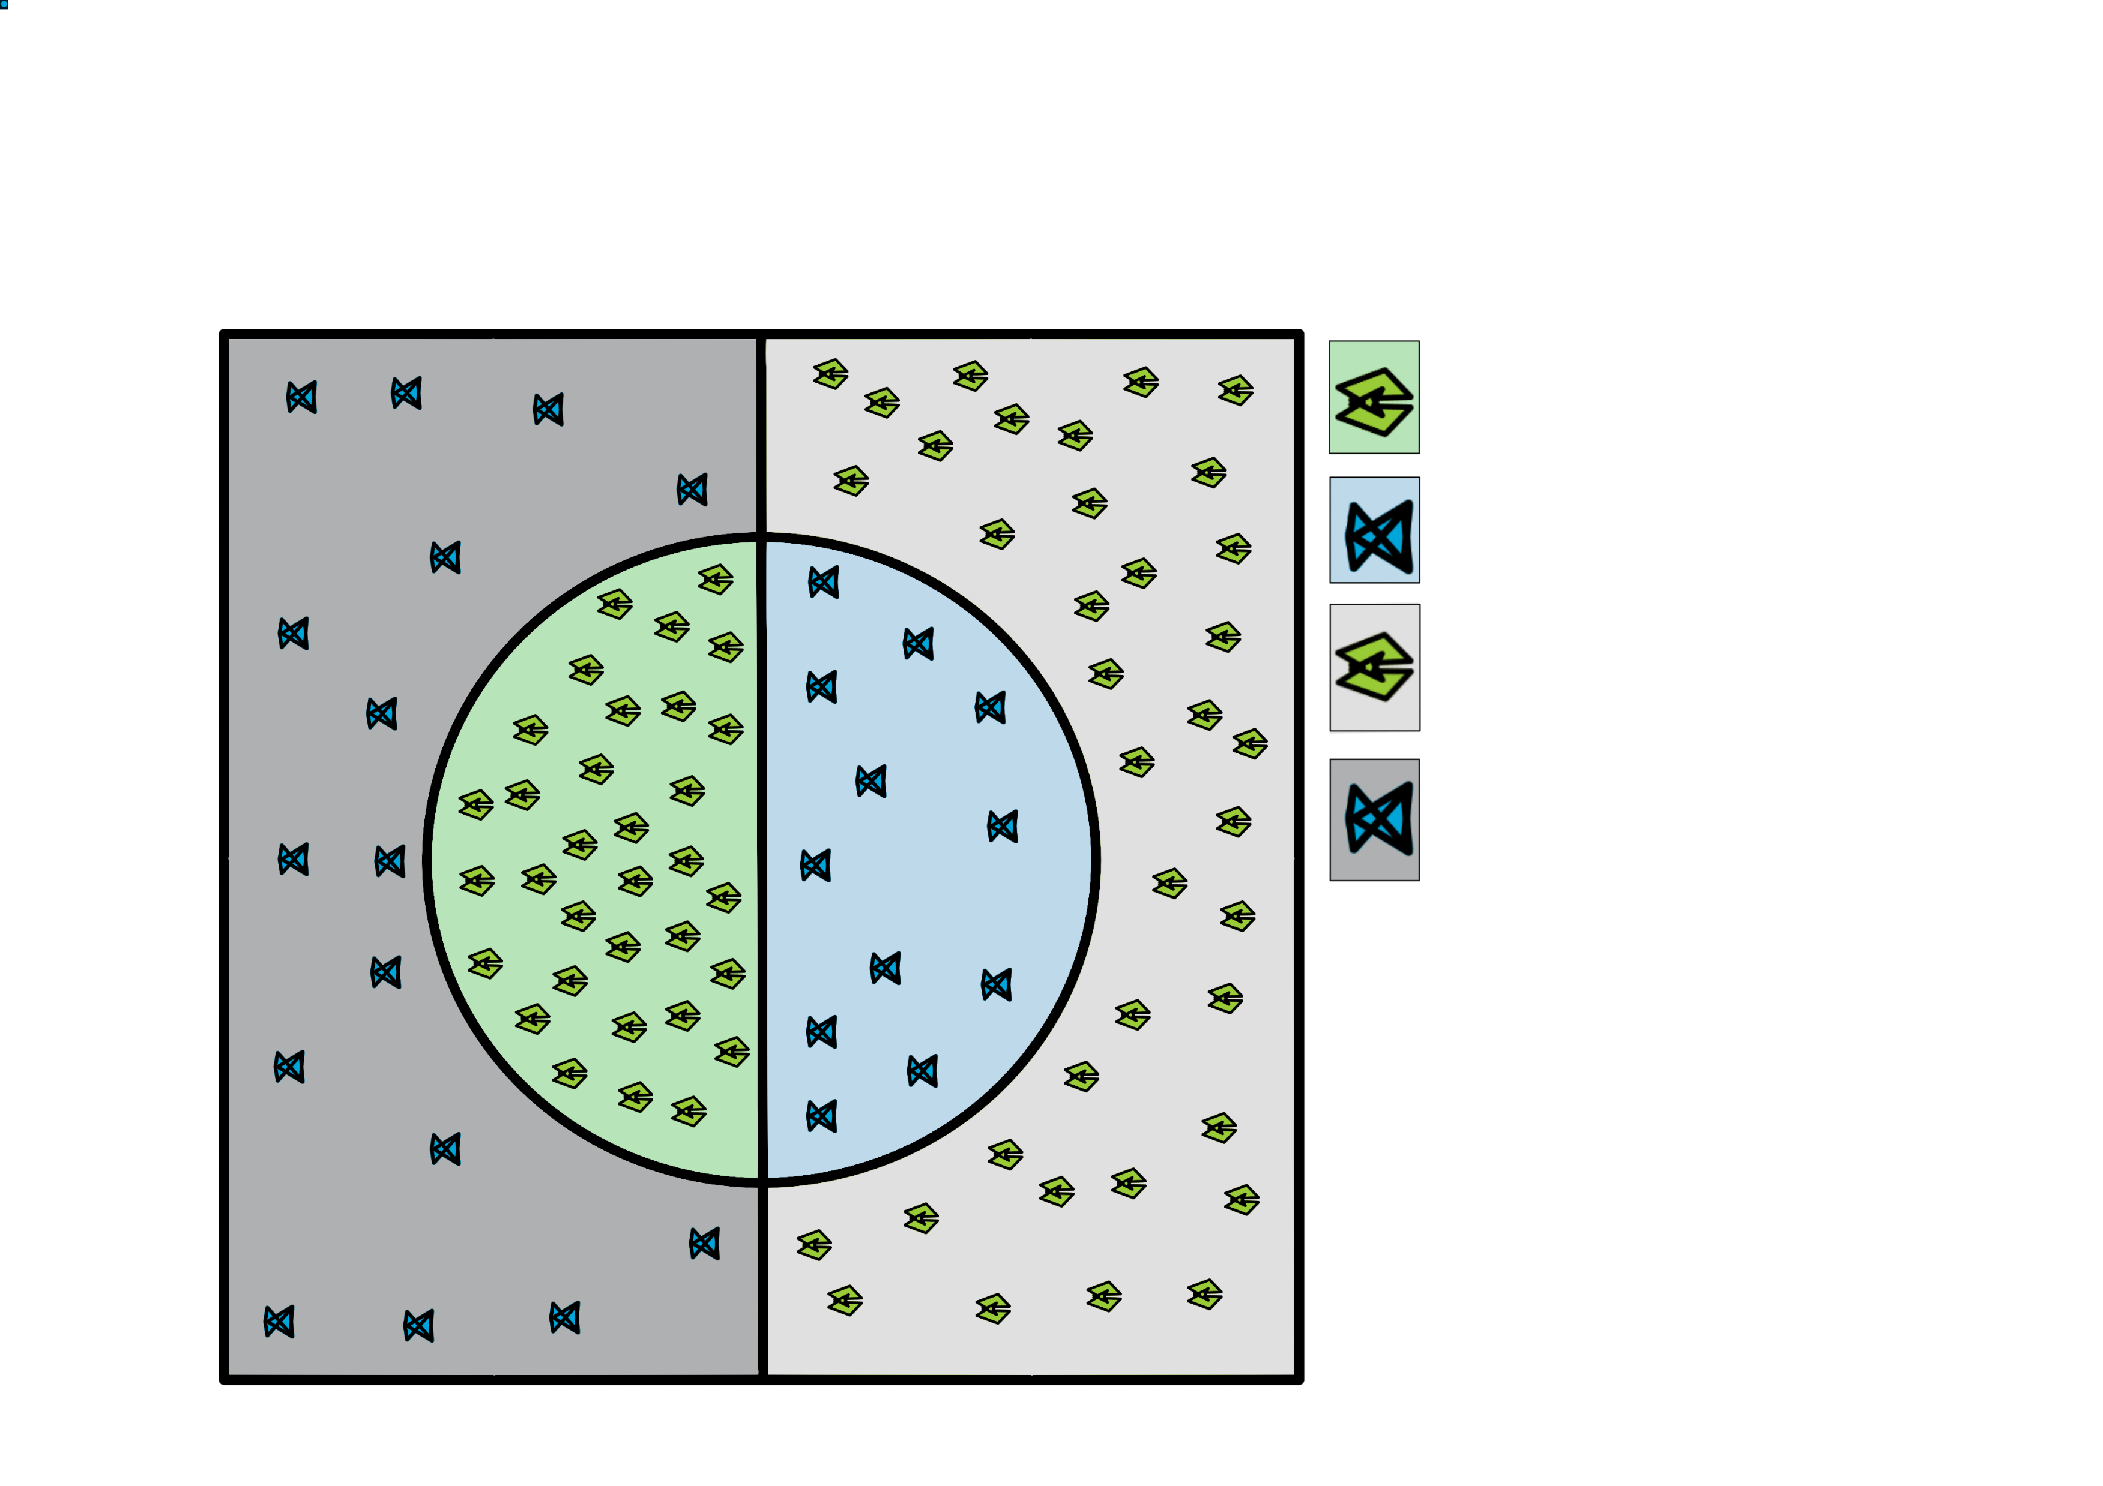
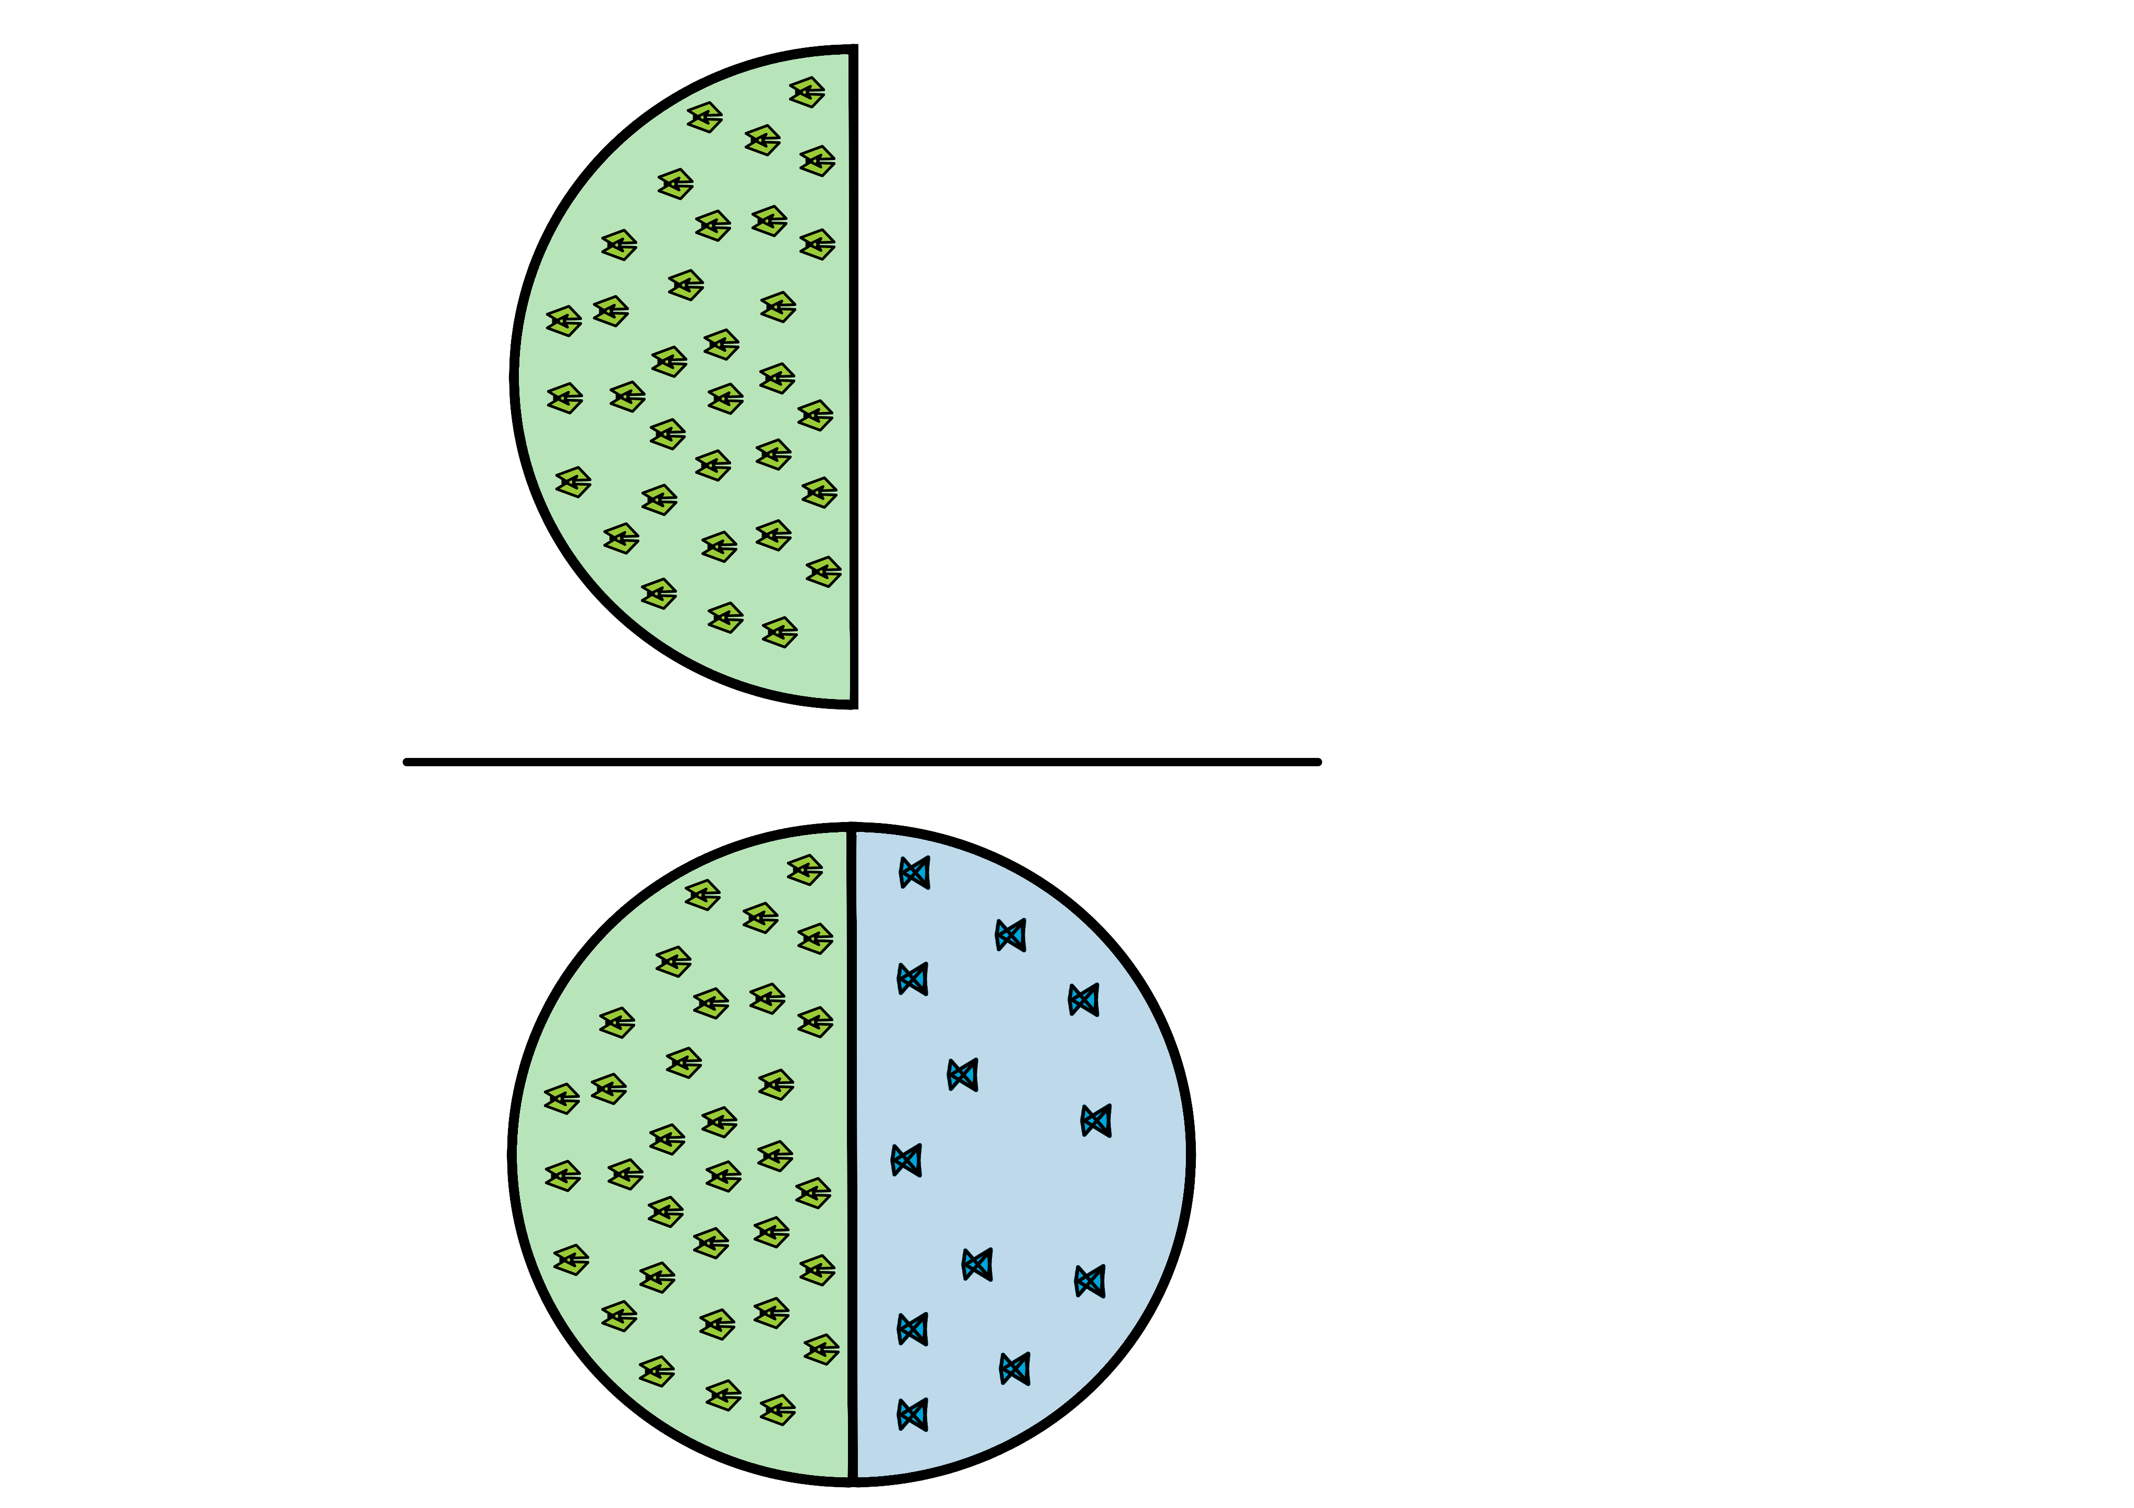
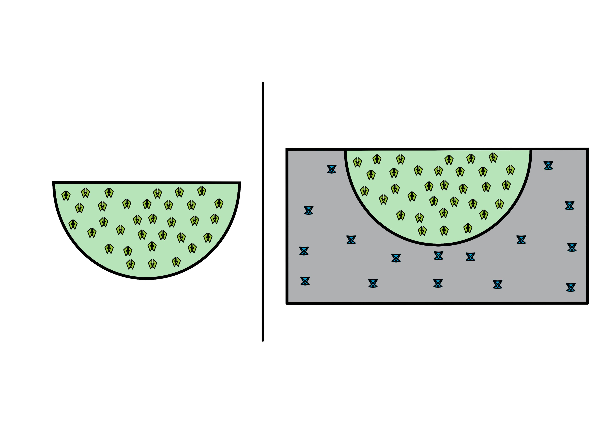
Evaluation Metrics
How many selected items are relevant?
How many relevant items are selected?
True Positive
False Positives
True Negatives
False Negative
Precision =
Recall =

Slide 8

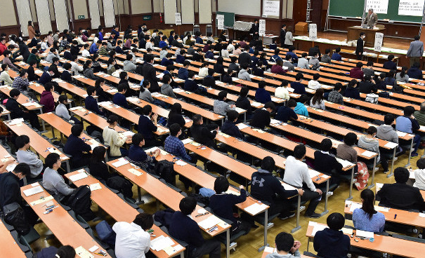
Evaluation Metrics
 | Training data set | Testing data set
Accuracy | 0.73 | 0.73
Precision | 0.81 | 0.75
Recall | 0.73 | 0.70
THE MAINICHI(2019), EIKEN TEST. HTTPS://BIT.LY/3NXMGLU
Parting from a training dataset of 135000 students and a test dataset of 45000 students, the decision tree proved to be highly accurate and precise. Nevertheless, recall is standard.

Slide 9


Time and Memory Consumption
Time Consumption
Memory Consumption

Slide 10
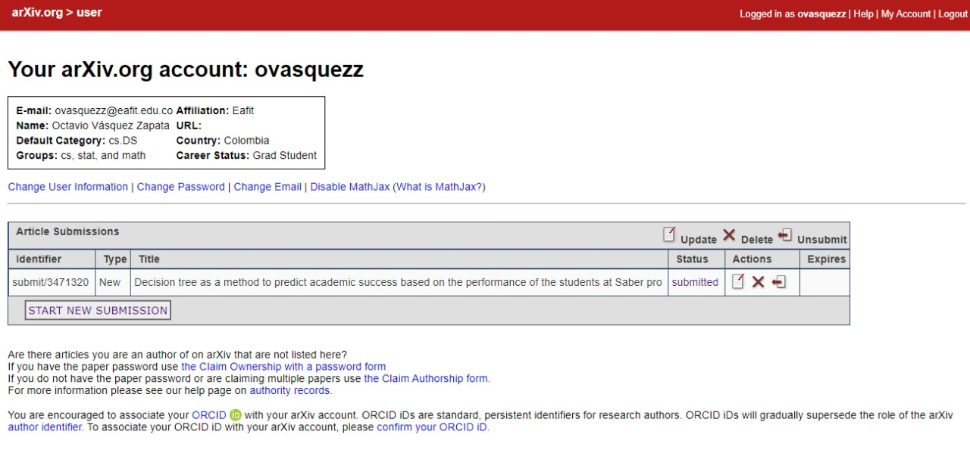
Report Accepted on arXiv
J. Echeverri, O. Vásquez, M. Correa, and M. Toro. Decision tree as a method to predict academic success based on the performance of the students at Saber pro, Nov. 2020. Available at: https://arxiv.org/submit/3471320/preview (provisional link)

Slide 11
THANK YOU!

